Slide 1



MEET Nur-D
(Matt Allen)
“Being unapologetically happy about what you’re doing is one of the biggest forms of resistance.”
(b. October 26, 1990)

Slide 2


WHO IS Nur-D?
Nur-D is a hip-hop artist, educator, and storyteller known offstage as Matt Allen, from Rosemount, MN.
His name offstage is Matt Allen, and he was born on October 26, 1990.
Although he was born in New York, Matt moved to Minnesota as a child and grew up here in Rosemount.

Slide 3


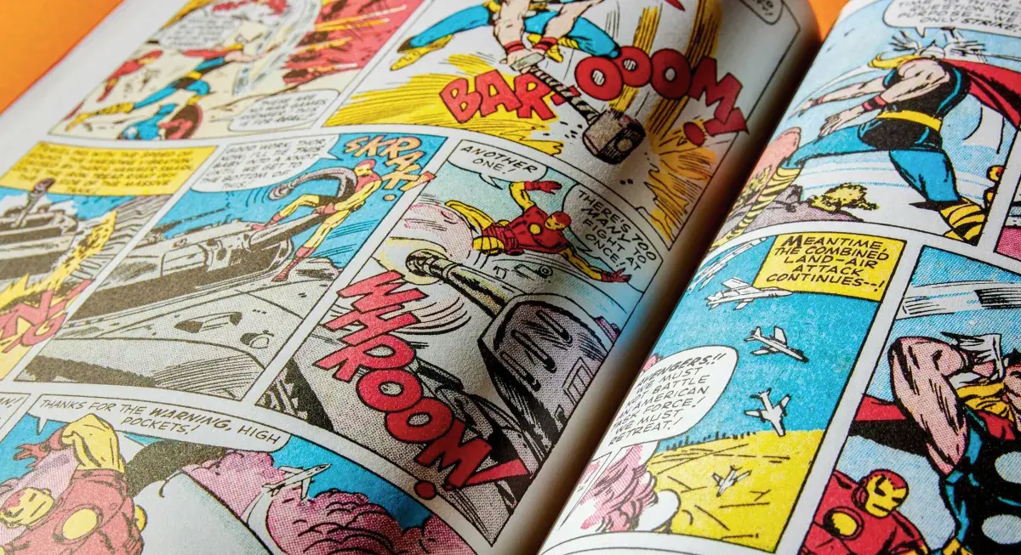
GROWING UP
He has described himself as a kid who was a little “weird” and a little different—and he learned to embrace those parts of himself.
Matt attended Rosemount High School, graduating
in 2009
His interests included comic books, superheroes, video games, professional wrestling, and ’80s hair metal.

Slide 4


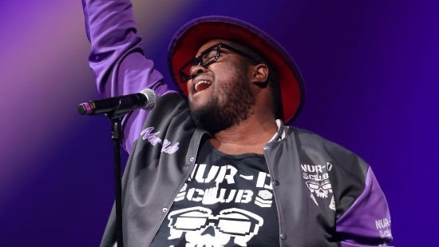

FINDING HIS VOICE
Rather than trying to fit into someone else’s idea of what an artist should be, NUR-D has built a style that is uniquely his own.
Nur-D uses hip-hop, humor, poetry, and storytelling to share ideas and connect with people.
His music often explores identity, joy, community, belonging, and what it means to be yourself.

Slide 5
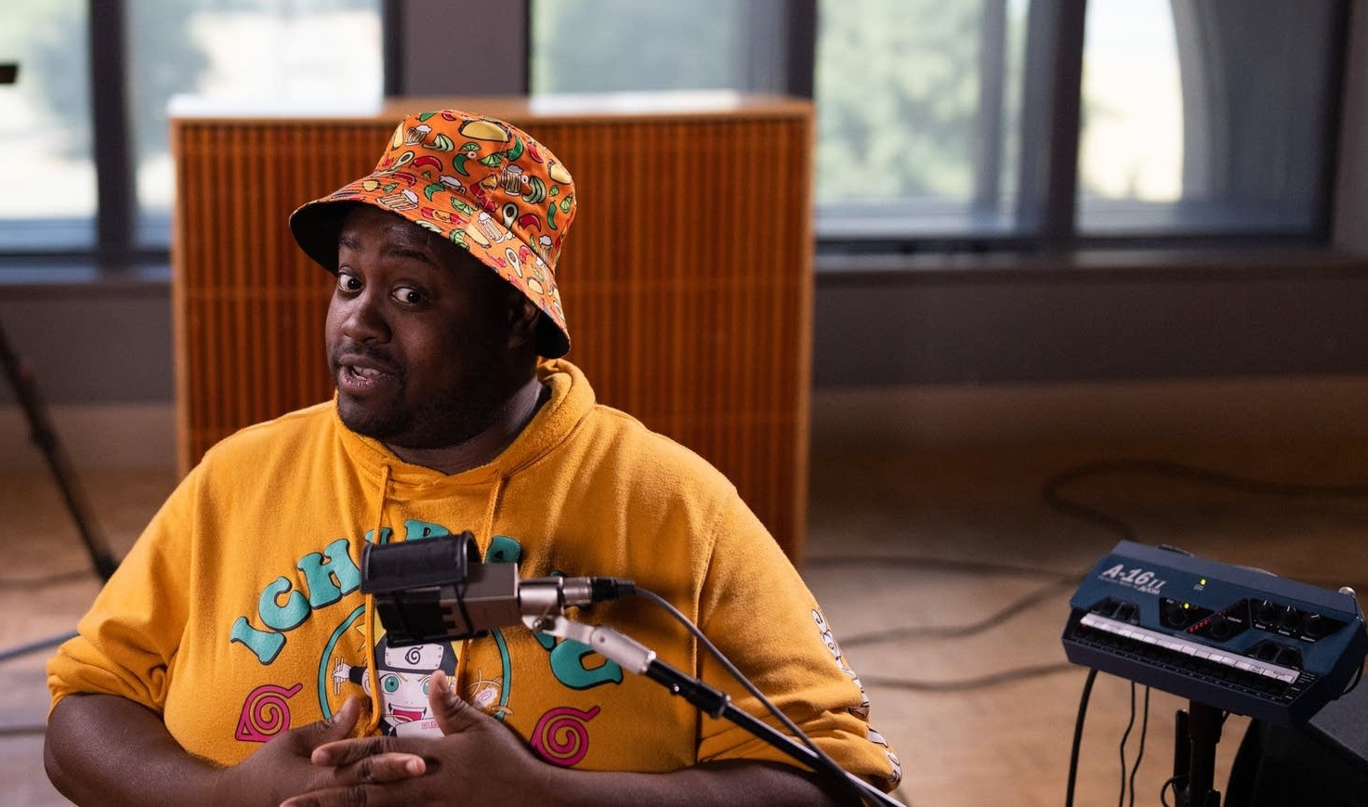



Nur-D AS A STORYTELLER
Storytelling is at the heart of NUR-D’s work.
Through music and performance, he tells stories about his experiences, the people around him, and the world he sees.
His work reminds us that stories do not have to look or sound one particular way.

Slide 6




WHY THE NAME Nur-D?
The name Nur-D is part of Matt’s identity as an artist.
He has embraced being a little different and being unapologetically himself.
Instead of hiding the things that make him “nerdy,” he celebrates them.
Being yourself can be a form of resistance.

Slide 7




RESISTENCE THROUGH UNAPOLOGETIC HAPPINESS
Joy as Resistance
Confidence in Creativity
Authenticity and Ambition
His message emphasizes that joy about your work can be a form of resistance
Staying confident in a unique creative path helps block pressure to conform
His journey shows how authenticity can coexist with competitive ambition

Slide 8


YOUR TURN
What makes YOU
who you are?
What are the experiences, people, interests, places, and ideas that have shaped your story?
Your story doesn't have to look like anyone else's.

